Slide 1
Advanced Machine Learning
BY
Adnan Amin

Slide 2
Regression

Slide 3
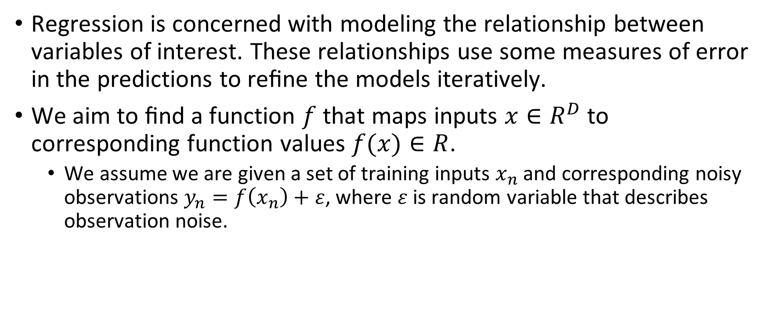
Definition:
Regression is concerned with modeling the relationship between variables of interest. These relationships use some measures of error in the predictions to reﬁne the models iteratively.
We aim to ﬁnd a function $f$ that maps inputs $x∈R^{D}$ to corresponding function values $f(x)∈R$.
We assume we are given a set of training inputs $x_{n}$ and corresponding noisy observations $y_{n}=f\left(x_{n}\right)+ε$, where $ε$is random variable that describes observation noise.

Slide 4
Objective:
To ﬁnd a function that not only models the training data, but generalizes well to predicting function values at input locations that are not part of the training data.
With simple linear regression we want to model our data as follows:
y= B0 + B1 * x

Slide 5
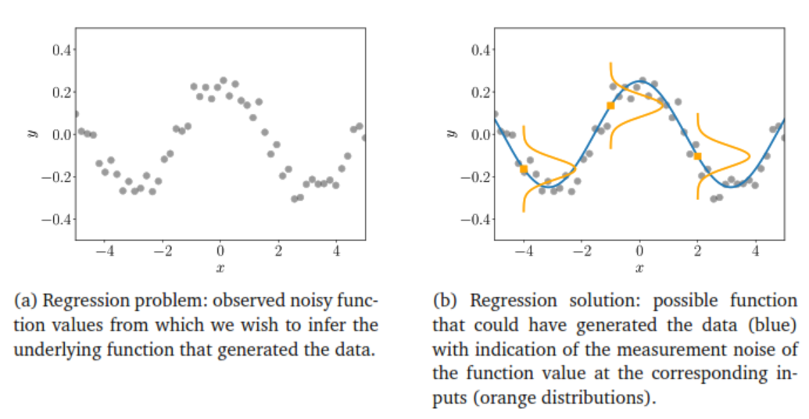
Regression Problem and Solution

Slide 6
Application Area of Regression
Time-series analysis
Control and robotics (reinforcement learning)
Optimization
Computer Games, speech to text translation, image recognition, automatic video annotation (Deep learning)

Slide 7
Linear Regression
Linear regression allows us to do that. Speciﬁcally, we want to see how a variable X affects a variable y.
Here, X is called the independent variable or predictor; y is called the dependent variable or response.
The X is in uppercase because it could have multiple feature vectors, making it a feature matrix. y is in lowercase because it is a single value or feature being predicted.
Linear regression ﬁts a line (or plane, or hyperplane) to the dataset.
For example,
we want to predict the annual return using excess return of stock in a stock portfolio. The line represents the relation between these two variables.

Slide 8
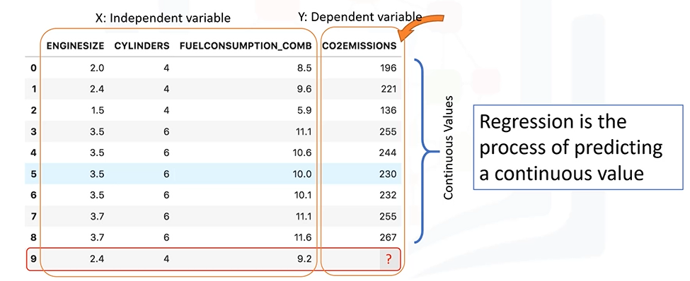

Slide 9
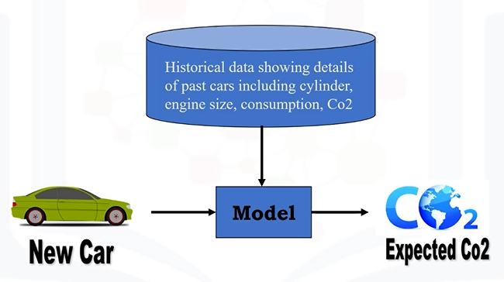

Slide 10
Two basic types of linear regression
Simple regression:
Simple regression is when one independent variable is used to estimate a dependent variable.
Simple linear regression
Simple non-linear regression
Multiple regression
When more than one independent variable is present
Multiple linear regression
Multiple non-linear regression
Predict co2emission vs EngineSize of all cars
Predict co2emission vs EngineSize and Cylinders of all cars
Notes:
Simple regression is when one independent variable is used to estimate a dependent variable.
It can be either linear on non-linear.
For example, predicting Co2emission using the variable of EngineSize.
====================
Linearity of regression is based on the nature of relationship between independent and dependentvariables.When more than one independent variable is present, the process is called multiple linearregression.For example, predicting Co2emission using EngineSize and the number of Cylinders inany given car.

Slide 11
Essentially, we use regression when we want to estimate a continuous value.
The key point in the linear regression is that our dependent value should be continuous and cannot be a discreet value.
The independent variable(s) can be measured on either a categorical or continuous measurement scale.

Slide 12
General Applications of Regression:
Sales forecasting
to predict a salesperson's total yearly sales from independent variables such as age, education, and years of experience.
Satisfaction analysis
to determine individual satisfaction based on demographic and psychological factors.
Price estimation
to predict the price of a house in an area, based on its size, number of bedrooms, and so on.
Employment income
to predict employment income for independent variables, such as hours of work, education, occupation, sex, age, years of experience, and so on.

Slide 13
Regression algorithm
Ordinal regression
Poisson regression
Fast forest quantile regression
Linear, Polynomial, Lasso, Stepwise, Ridge regression
Bayesian linear regression
Neural network regression
Decision forest regression
Boosted decision tree regression
KNN

Slide 14
1. Simple Linear Regression
In simple linear regression, there are two variables: a dependent variable and an independent variable.
when one independent variable is used to estimate a dependent variable.
For example, predicting Co2 emission using the EngineSize variable.
Independent variable (x): EngineSize
Dependent variable (y): co2emission

Slide 15
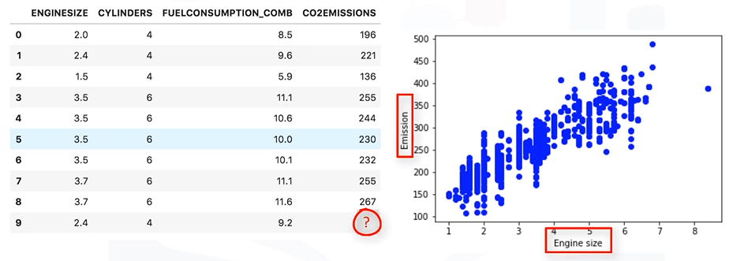
How linear regression works?
Notes:
We show Engine size as an independent variable, and Emission as the target value that we would like to predict. A scatterplot clearly shows the relation between variables where changes in one variable "explain" or possibly "cause" changes in the other variable. Also, it indicates that these variables are linearly related.

Slide 16
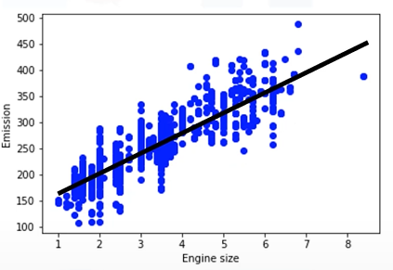
How to draw/determine which line ‘fits best’?
Notes:
With linear regression you can fit a line through the data. For instance, as the EngineSize increases, so do the emissions. With linear regression, you can model the relationship of these variables.

Slide 17
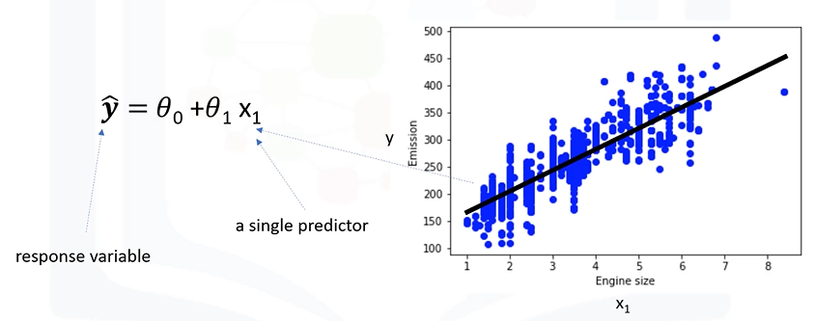
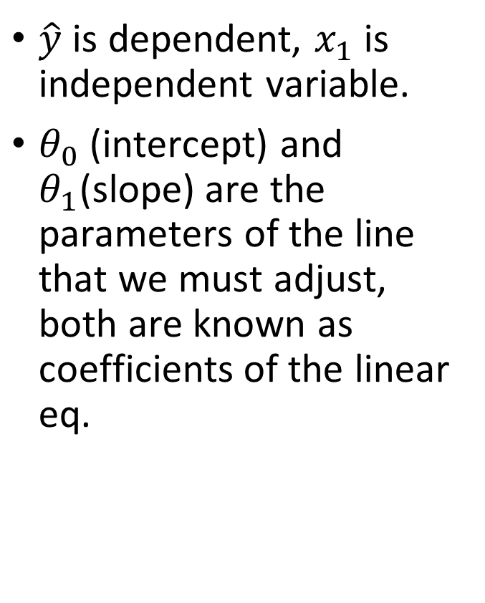
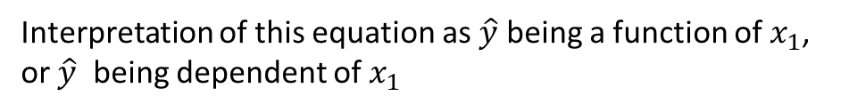
Linear regression model representation
$\hat{y}$ is dependent, $x_{1}$ is independent variable.
$θ_{0}$ (intercept) and $θ_{1}$(slope) are the parameters of the line that we must adjust, both are known as coefficients of the linear eq.
Interpretation of this equation as $\hat{y}$ being a function of $x_{1}$, or $\hat{y}$ being dependent of $x_{1}$

Slide 18
How to draw/determine which line ‘fits best’?
Linear regression estimates the coefficients of the line.
This means we must calculate θ0 and θ1 to find the best line to ‘fit’ the data.

Slide 19
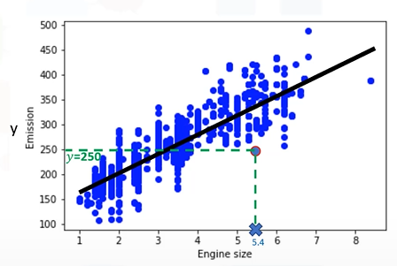

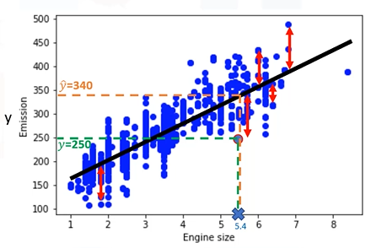

How to find the best fit?
a car with engine size x1=5.4, and actual Co2=250, its Co2 should be predicted very close to the actual value, which is y=250, based on historical data.
But, if we use the fit line , using our polynomial with known parameters to predict the Co2 emission, it will return y ̂ =340.

Slide 20
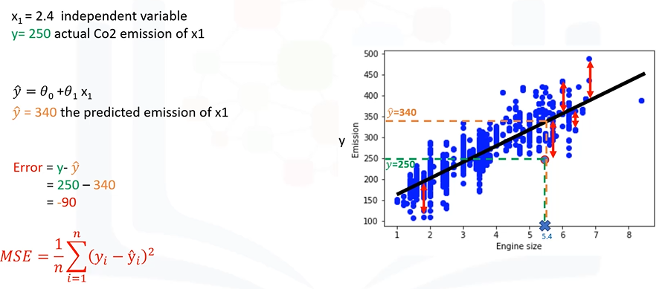
How to fin the best fit
Prediction line is not accurate because error value is 90-unit, known as residual error.
MSE (mean squared error)
Objective: Linear regression should minimize the mean error of the prediction using the fit line.
How: find the best parameters for θ0 and θ1
Option 1: Random guess (not recommended)
Option 2: optimization approach
Option 3: mathematic approach

Slide 21
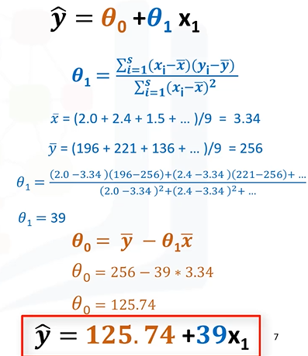
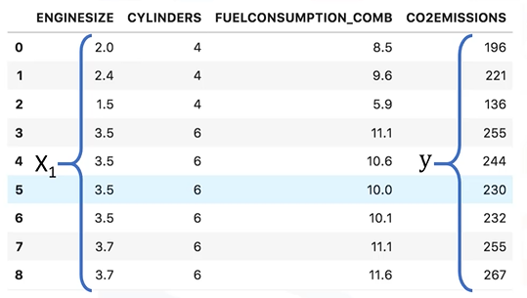

Mathematical formula to find the coefficients of best fit line
We can estimate θ0 (intercept) and θ1 (slope of the line directly from the data.
Calculate the mean of the independent and dependent variables from the dataset.
Notes:
Please consider that we have 9 rows here, row 0 to 8.
1.First, we calculate the average of x1 and average of y.
2.Then we plug it into the slope equation, to find θ1.
3.The xi and yi in the equation refer to the fact that we need to repeat these calculations across all values in our dataset and i refers to the i’th value of x or y.

Slide 22
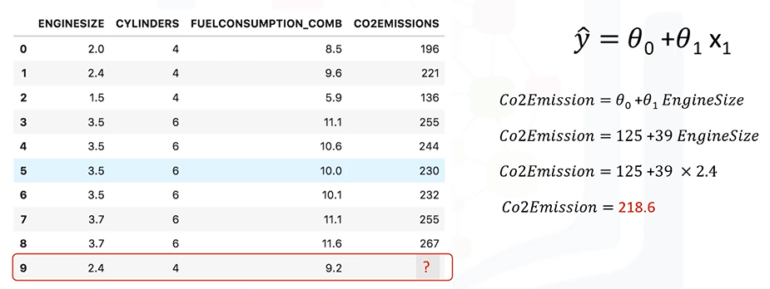
Predictions with linear regression

Slide 23
Why use linear regression?
One reason: it is very fast
There is no need of parameter tuning
Easy to understand, and highly interpretable

Slide 24
Multiple Linear Regression

Slide 25
Simple & Multiple Linear Regression
When we have a single input variable (x) and we want to use linear regression, this is called simple linear regression.
If we have multiple input variables (e.g., x1, x2, …xn), this is called multiple linear regression.
For example, predicting Co2 emission using the EngineSize and Cylinders variables.
Independent variable (x): EngineSize, Cylinders, etc.
Dependent variable (y): co2emission

Slide 26


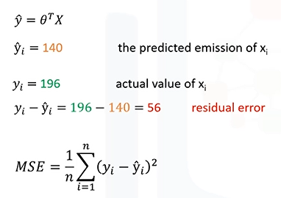



Predicting continuous values with multiple linear regression
Mathematically we can express as (vector form):

Slide 27
Estimating multiple linear regression parameters
How to estimate the coefficients (intercept and slope)?
Ordinary least squares (OLS)
Linear algebra operations
Takes a long time for large datasets (approx. 10K+ samples)
An optimization algorithm
Gradient descent
A proper approach if you have a very large dataset

Slide 28
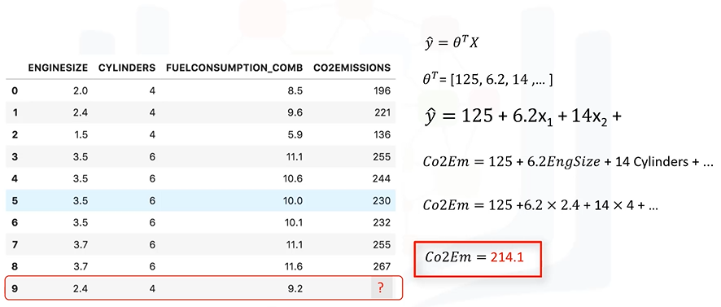
Making predictions with multiple linear regression

Slide 29
Q&A– on multiple linear regression
Q1: How many independent variables should we use for the prediction?
Should we use all the fields in our dataset?
Does adding independent variables to a multiple linear regression model always increase the accuracy of the model?
Q2: Should independent variables be continuous?
Q3: What are the linear relationships b/w the dependent variable and the independent variable?
Notes:
Q1. Ans. Basically, adding too many independent variables without any theoretical justification may result in an over-fit model. An over-fit model is a real problem because it is too complicated for your data set and not general enough to be used for prediction. So, it is recommended to avoid using many variables for prediction.
Q2. Ans. Basically, categorical independent variables can be incorporated into a regression model by converting them into numerical variables. For example, given a binary variable such as car type, the code dummies “0” for “Manual” and 1 for “automatic” cars.
Q3. remember that “multiple linear regression” is a specific type of linear regression. So, there needs to be a linear relationship between the dependent variable and each of your independent variables. There are a number of ways to check for linear relationship. For example, you can use scatterplots, and then visually check for linearity. If the relationship displayed in your scatterplot is not linear, then, you need to use non-linear regression.

Slide 30
Gradient Decent based optimization

Slide 31
Gradient Descent
When there are one or more inputs you can use a process of optimizing the values of the coefficients by iteratively minimizing the error of the model on your training data.
How does it work?
Starting with zero values for each coefficient
The sum of squared errors are calculated for each pair of input and output values
Learning rate is used as a scale
Coefficients are updated in the direction towards minimizing the error
Iterate until a minimum sum squared error is achieved (no further improvement)

Slide 32
Model Evaluation Approaches

Slide 33
Model Evaluation Approaches
The goal of regression is to build a model to accurately predict an unknown case.
perform regression evaluation after building the model.
There two types of evaluation approaches:
Train/ test on the same dataset
Train/test split

Slide 34
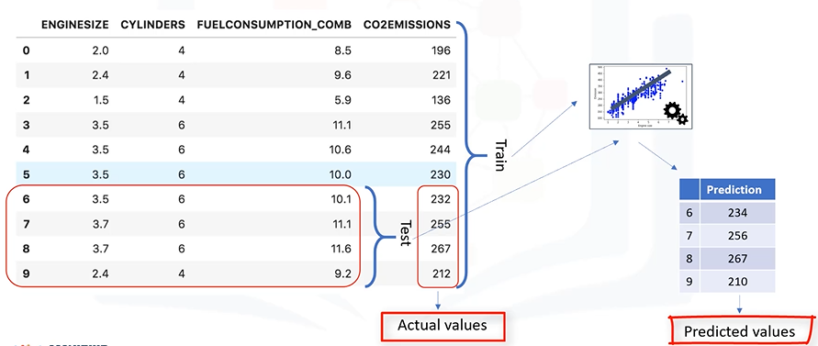
Approach # 1

Slide 35
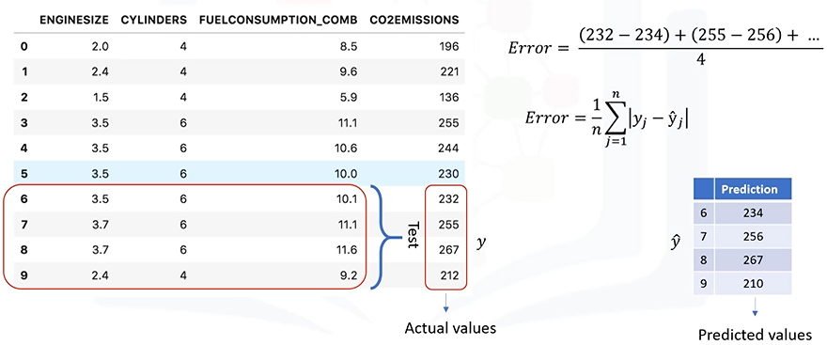
Calculating the accuracy of a model

Slide 36
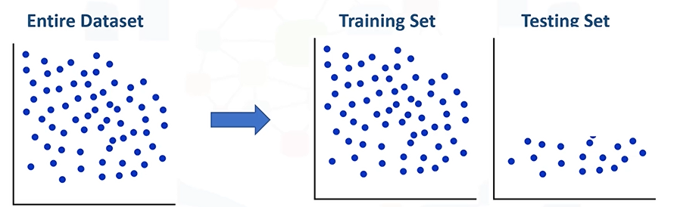
1. Train and test on the same dataset
This evaluation approach would most likely have a high “Training Accuracy”: and low “out-of-sample accuracy”. Since the model knows all the testing data points.

Slide 37
1.1 Training Accuracy and Out-of-sample Accuracy
It is the percentage of correct predictions that the model makes when using the test dataset.
Is high training accuracy a good thing?
Out-of-sample accuracy:
It is the percentage of correct predictions that the model makes on data that the model has not been trained on.
doing a “train and test” on the same dataset will most likely have low out-of-sample accuracy due to the likelihood of being over-fit.
Which one is better?
Notes:
Q: Is high training accuracy a good thing?
Ans: For instance, having a high training accuracy may result in an ‘over-fit’ of the data. This means that the model is overly trained to the dataset, which may capture noise and produce a non-generalized model.
Q. Which one is better?
Ans. It’s important that our models have high, out-of-sample accuracy, because the purposeof our model is, of course, to make correct predictions on unknown data.

Slide 38
How to improve out-of-sample accuracy?
One way is to use another evaluation approach called "Train/Test Split."

Slide 39
2. Train/Test Split
Select a portion of the dataset for training, model is built on the training set.
For example, rows 0 to 5 for training.
The rest of the portion which left used for the test set.
For example, rows 6 to 9 for testing.
The test data is passed to the already trained model for prediction.
Finally, the predicted values for the test set are compared with the actual values of the testing set.

Slide 40
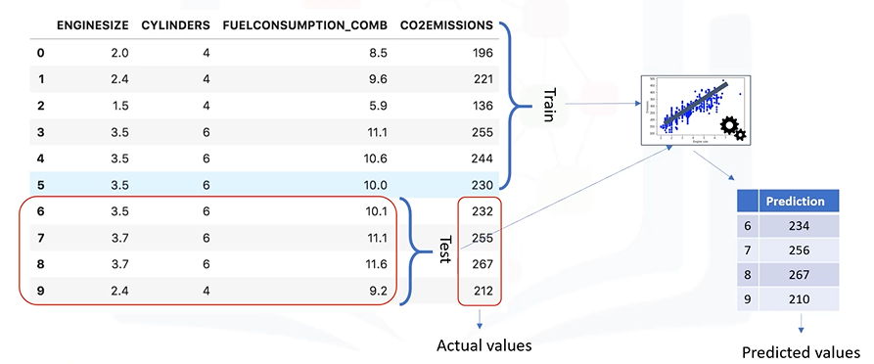
Train/Test Split Model Evaluation approach

Slide 41
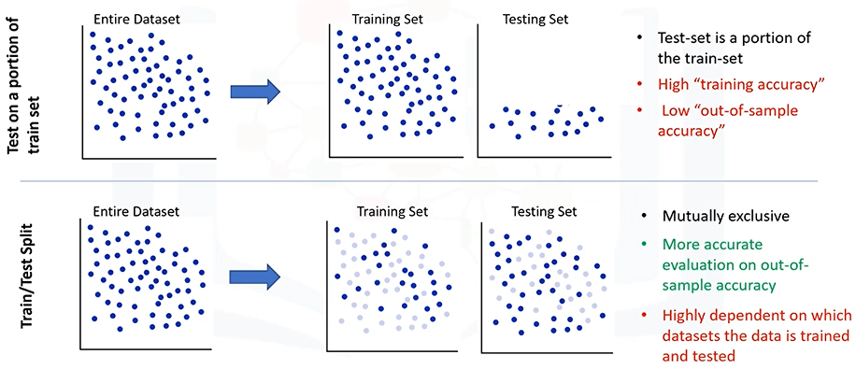
Train/Test split evaluation approach

Slide 42
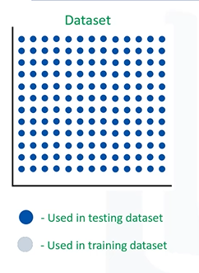
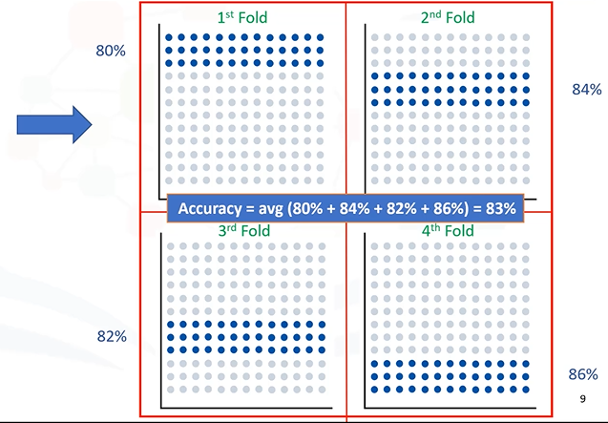
K-fold cross-validation?

Slide 43
Evaluation Metrics in Regression Models

Slide 44
Evaluation metrics
Compare the actual values and predicted values to calculate the accuracy of a regression model.
Metrics can be used for quantifying of your prediction.
Regression accuracy
MAE: Mean Absolute Error
MSE: Mean Square Error
RMSE: Root Mean Square Error
What an error?

Slide 45
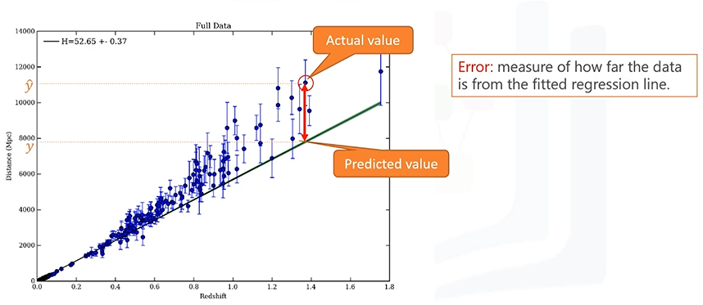
Regression error?
In the context of regression, the error of the model is the difference between the data points and the trend line generated by the algorithm.

Slide 46

1. Mean Absolute Error (MAE)
The mean of the absolute value of the errors.
This is the easiest of the metrics to understand, since it’s just the average error.

Slide 47

2. Mean Squared Error (MSE)
the mean of the squared error.
It’s more popular than Mean absolute error because the focus is geared more towards large errors.
This is due to the squared term exponentially increasing larger errors in comparison to smaller ones.

Slide 48

3. Root Mean Squared Error (RMSE)
The square root of the mean squared error.
This is one of the most popular of the evaluation metrics because Root Mean Squared Error is interpretable in the same units as the response vector (or ‘y’ units) making it easy to relate its information.

Slide 49

4. Relative Absolute Error (RAE)
also known as Residual sum of square,
where y-bar is a mean value of y, takes the total absolute error and normalizes it by dividing by the total absolute error of the simple predictor.

Slide 50

5. Relative Squared Error (RSE)
Like RAE, but it is used for calculating the R-squared.
R-squared:
A popular metric for the estimating the accuracy of model.
Represents how close the data values are to the fitted regression line.
The higher the R-squared, the better the model fits your data.

Slide 51
Non-Linear Regression

Slide 52
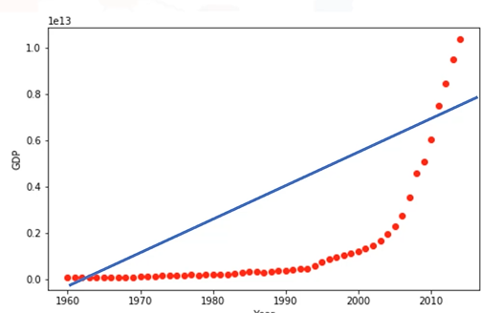
Non-Linear Regression
Nonlinear regression refers to situations where the relationship between the dependent variable and the independent variables is not linear in the parameters.
Can GDP be predicted based on time?
Can we use a simple linear regression to model it?
Indeed, if the data shows a curvy trend, then linear regression will not produce very accurate results when compared to a non-linear regression.

Slide 53
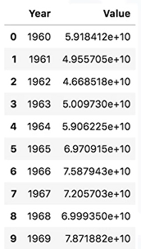
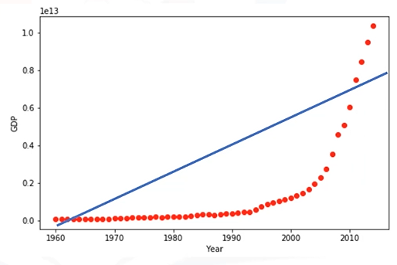
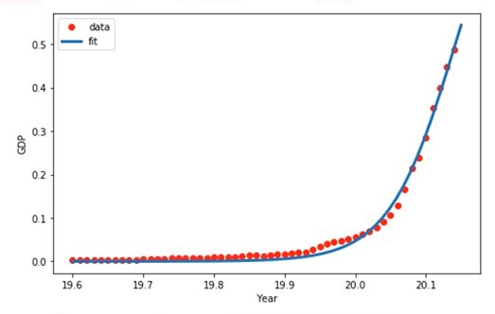
Should we use linear regression?

Slide 54
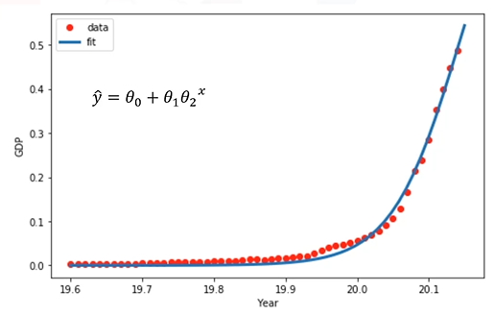

Slide 55
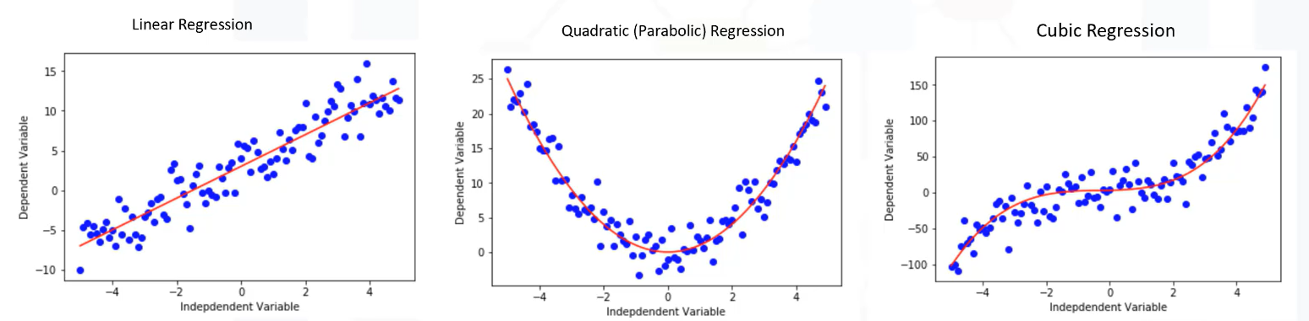
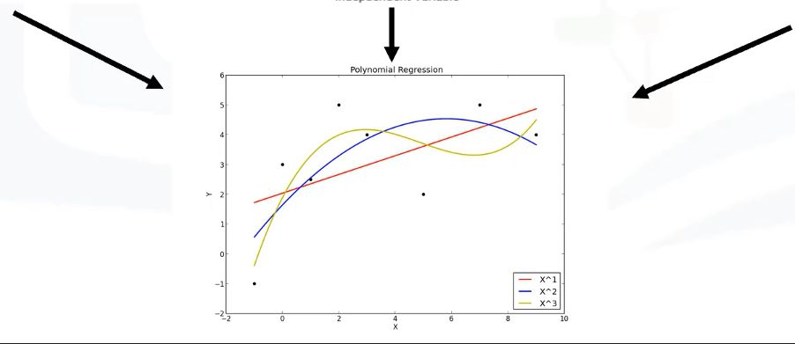
Different Types of Nonlinear Regression

Slide 56
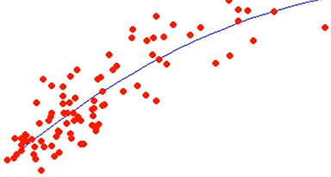



Polynomial Regression?
Some curvy data can be modeled by a polynomial regression.
Polynomial regression fits a curved line to your data.
Where the relationship between the independent variable x and the dependent variable y is modelled as an nth degree polynomial in x.
A polynomial regression model can be transformed into linear regression model.
3rd Degree polynomial regression.

Slide 57
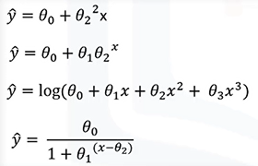
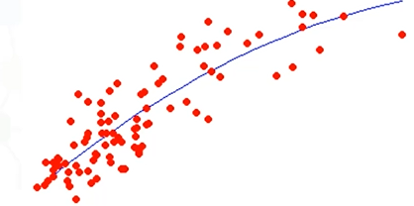
Nonlinear equations can be:
it can be the shape of:
exponential,
logarithmic,
Logistic,
or many other types.

Slide 58
Q&A
Q1: How can I now if a problem is linear or nonlinear in an easy way.
Inspect visually
Based on accuracy
Q2: How should I model my data, if it displays non-linear on a scatterplot?”
Notes:
Q1. Ans: It’s best to plot bivariate plots of output variables with each input variable. Also, you can calculate the correlation coefficient between independent and dependent variables, and if for all variables it is 0.7 thus, it’s not appropriate to fit a non-linear regression. we cannot accurately model the relationship with linear parameters.
Q2: you have to use either
a polynomial regression, use a non-linear regression model, or "transform" your data.

